Slide 2

0
2
Lesson 02
Counting II-Permutation

Slide 3
Lead in

Slide 4

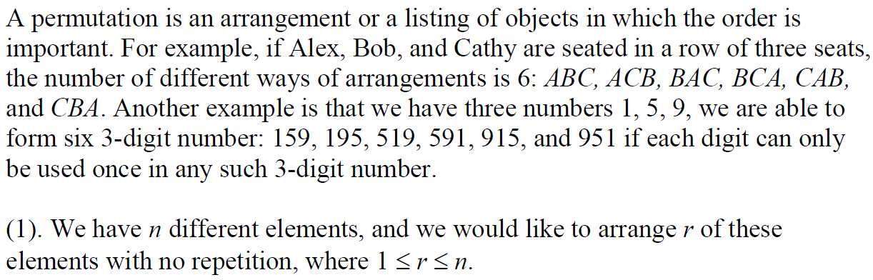
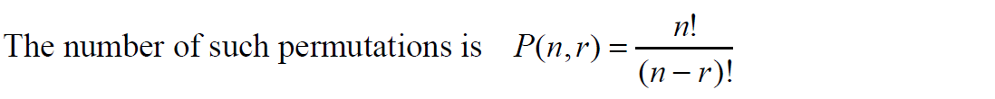
Lead in

Slide 5
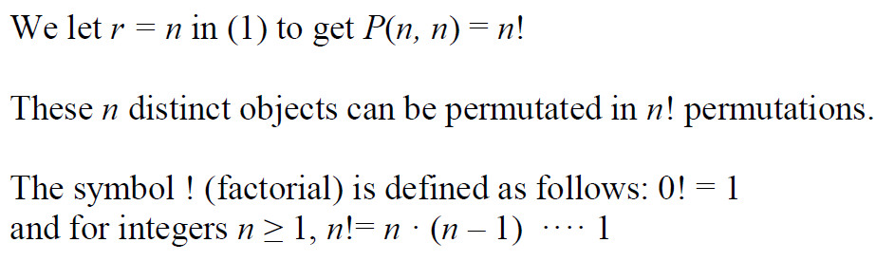
Lead in

Slide 6
Part 1
Permutation Basic

Slide 7

Example

Slide 8
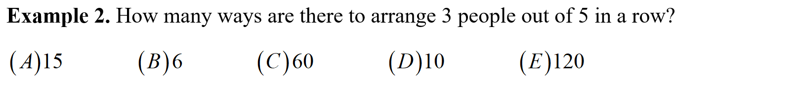
Example

Slide 9
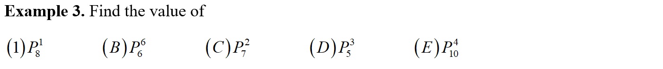
Example

Slide 10
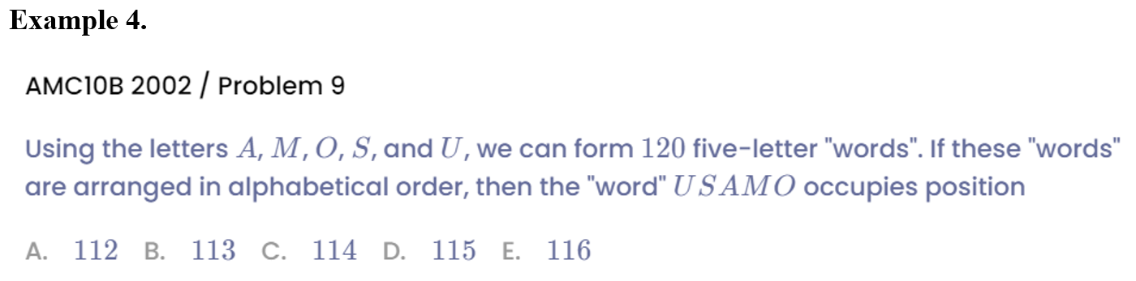
Example

Slide 11
Part 2
Binding Method

Slide 12
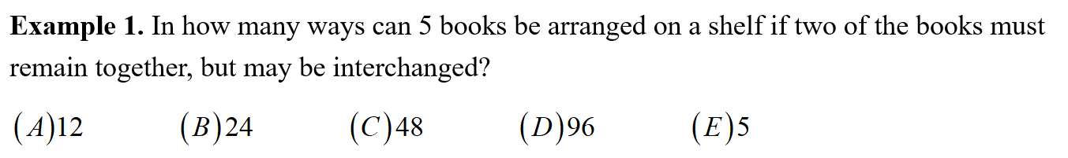
Example

Slide 13
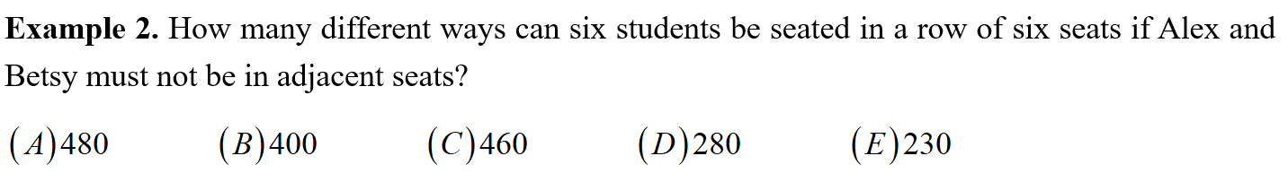
Example

Slide 14
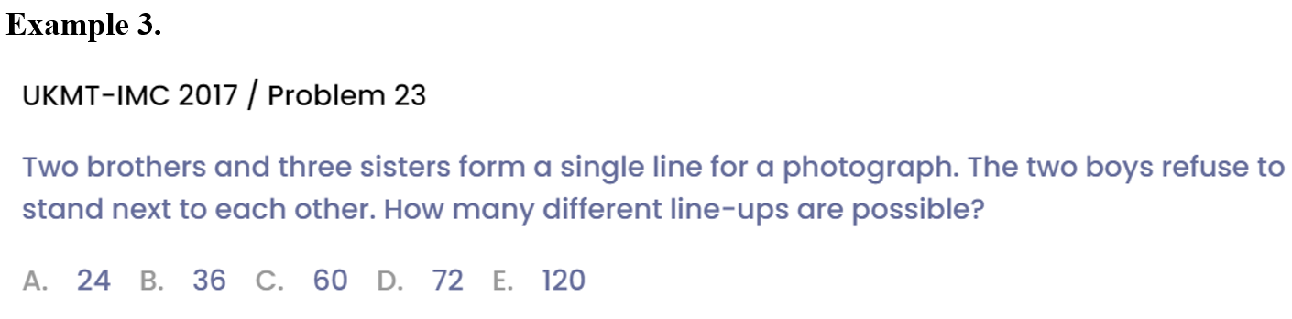
Example

Slide 15
Part 3
Grouping

Slide 16
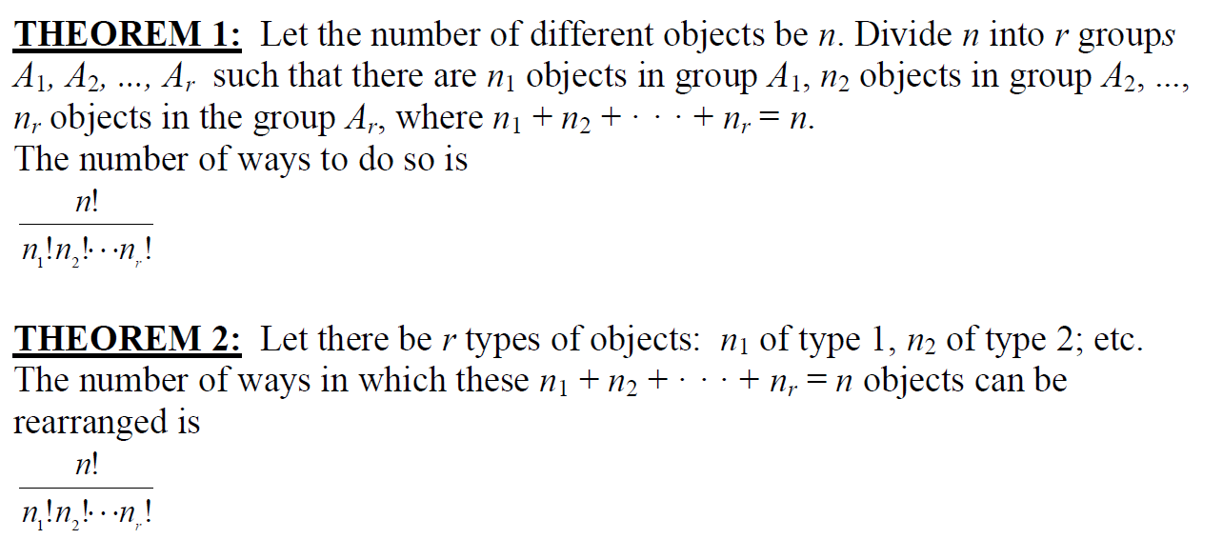
Lead in

Slide 17
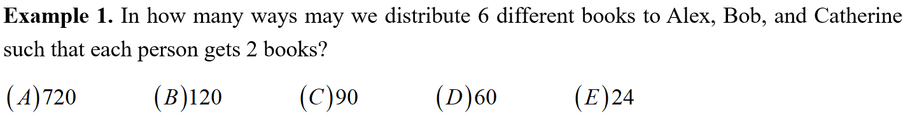
Example

Slide 18
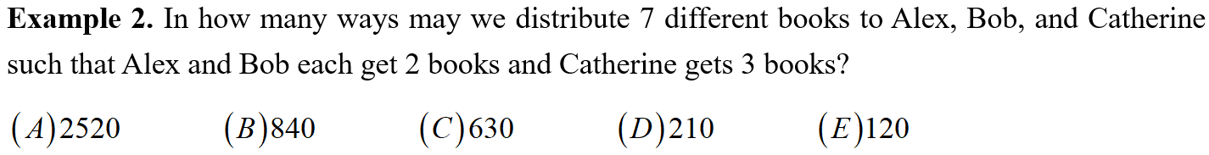
Example

Slide 19
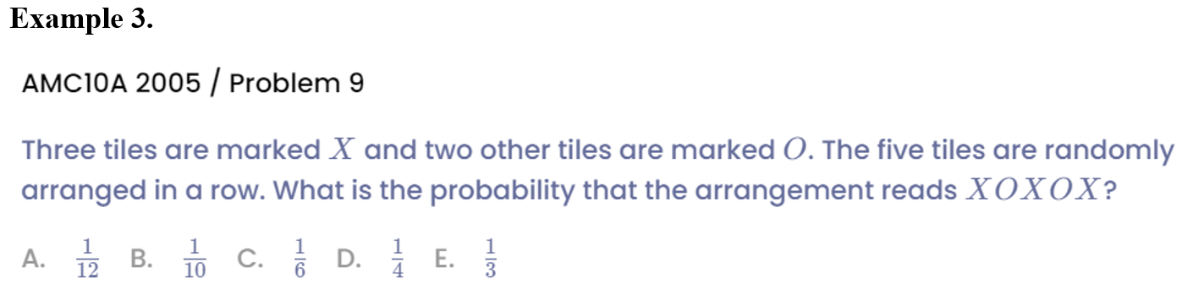
Example

Slide 20
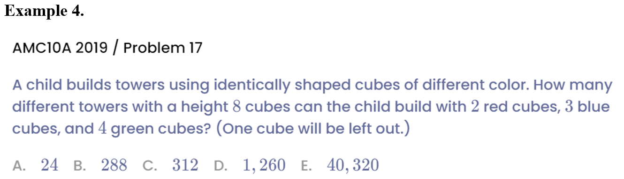
Example

Slide 21
Part 4
Circular Permutation

Slide 22

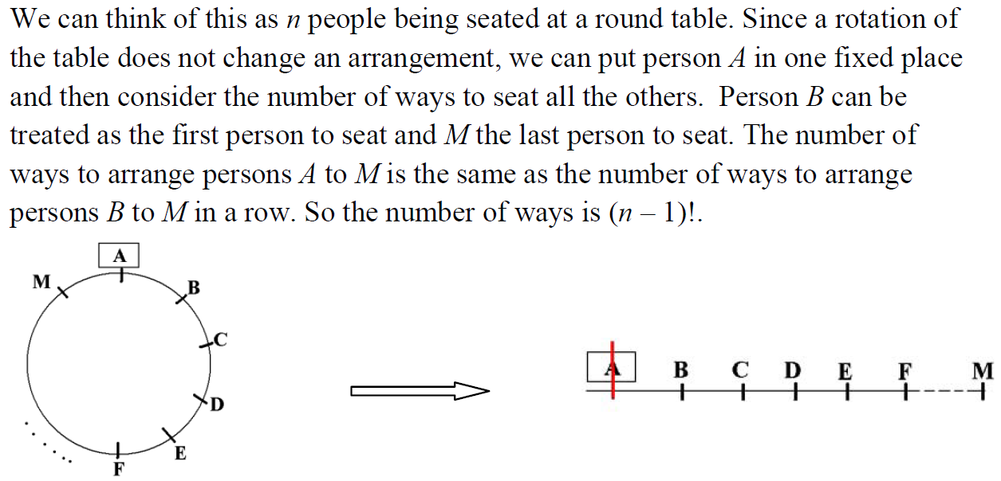
Lead in

Slide 23
Example

Slide 24
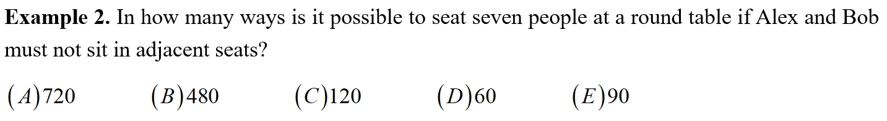
Example

Slide 25
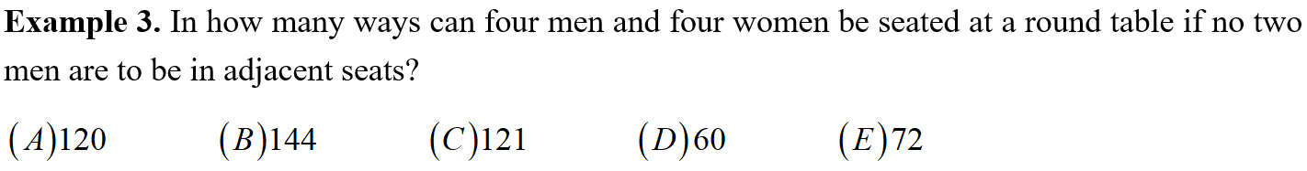
Example

Slide 26
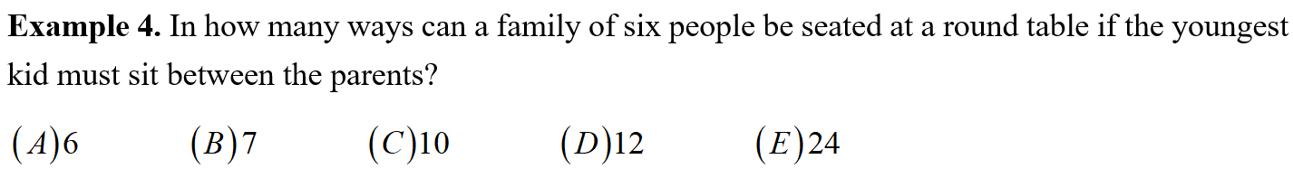
Example

Slide 27
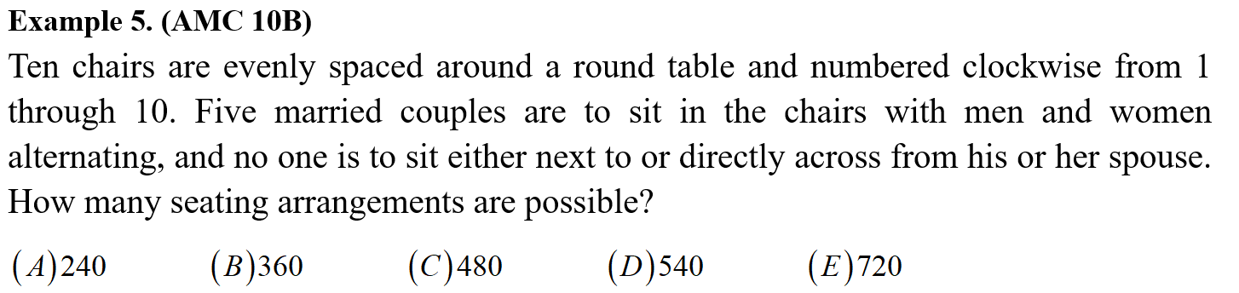
Example

Slide 28
Part 5
Classification and Permutation

Slide 29
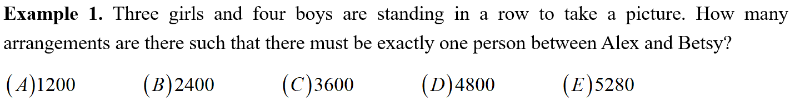
Example

Slide 30
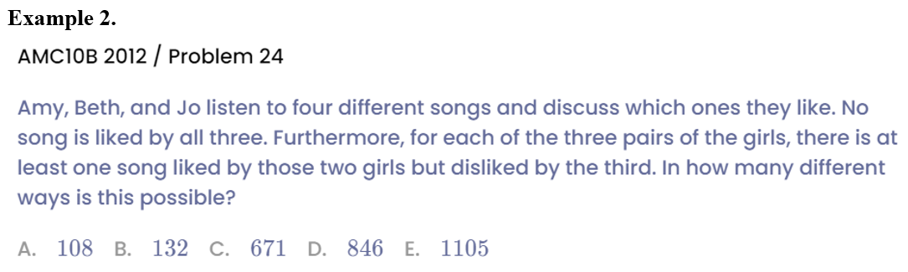
Example

Slide 31
See You Next Time!

